Slide 1


MACROMOLECULE Jeopardy-2
Category 1 | Category 2 | Category 3 | Category 4 | Category 5
10 | 10 | 10 | 10 | 10
20 | 20 | 20 | 20 | 20
30 | 30 | 30 | 30 | 30
40 | 40 | 40 | 40 | 40
50 | 50 | 50 | 50 | 50

Slide 2

Term for the loss of functional shape of a protein
denaturation
Notes:
Category 1 - 10

Slide 3
Molecule that assists in protein folding
chaperonin
Notes:
Category 1 - 20

Slide 4
DAILY DOUBLE
Major purpose of RNA
protein synthesis

Slide 5
Flow of genetic info when making a protein—put in order (RNA, DNA, Protein)
DNA to RNA to Protein

Slide 6
What are the 3 parts of a
Nucleotide?
Phosphate, sugar, nitrogen base

Slide 7
Which 2 DNA bases are pyrimidines?
Thymine, cytosine

Slide 8
Which two DNA bases are purines?
Adenine and guanine

Slide 9
What RNA base replaces thymine?
uracil

Slide 10
Main difference in deoxyribose
And ribose?
Deoxyribose has one less oxygen

Slide 11
3 differences between DNA & RNA
The sugar, DNA is double stranded,
DNA has thymine not uracil

Slide 12
What connects the 2 nitogen bases in
DNA?
Hydrogen bonds

Slide 13
If one strand of DNA is
3’ATTCGA5’
What is the complementary strand?
5’TAAGCT3’

Slide 14
What allows DNA to replicate accurately?
Complementary base pairing

Slide 15
Which group are not true polymers?
lipids

Slide 16
What is a structural polysaccharide in
Fungi cell walls and exoskeletons?
chitin

Slide 17
What type of reaction would break a protein down into amino acids?
hydrolysis

Slide 18
What base always bonds with
Adenine?
thymine

Slide 19
What bond connects the phospate to
the sugar on the sides of DNA?
covalent

Slide 20
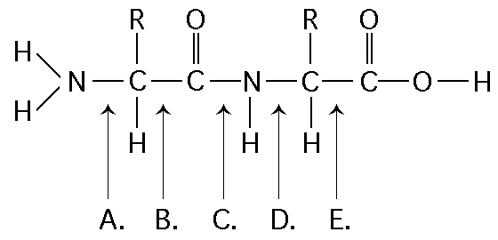
Where is the bond near the end carboxyl?
e

Slide 21
What is the key to a proteins function?
Shape!

Slide 22
A covalent bond formed between sulfurs in amino acid R groups that maintains the tertiary structure is called a
Disulfide bridge

Slide 23
If you see Nitrogens in a molecule
that looks coiled, but no
Phosphates, it is probably
An alpha helix secondary structure of a protein

Slide 24
Which bond is connecting the terminal
amine to the central carbon?
Which
^{A}

Slide 25
Why can we not digest cellulose?
Do not have the enzyme to hydrolyze the beta glycosidic linkages

Slide 26
If a polysaccharide of 400 glucose
Molecules undergoes total hydrolysis,
how many water molecules would
be formed?
399

